Slide 1
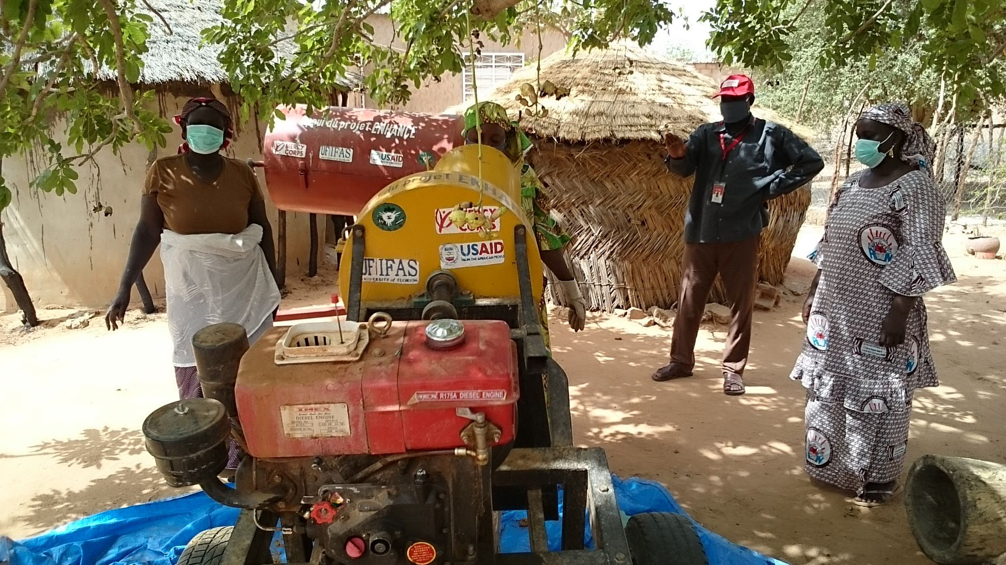
Enhancing the productivity of small ruminants through improved and cost-effective feeding and animal health interventions in Burkina Faso & Niger
May 2018 − December 2020
Principal Investigator
Dr. Salissou Issa, Government of Niger Institut National de la Recherche Agronomique du Niger, INRAN (Lead Objective 1)
Co-PI and Collaborators
Dr. Amadou Traore, Government of Burkina Faso Institut de l'Environnement et de Recherches Agricoles INERA/CNRST (Lead Objective 2)
Dr. Saidou Tembley, Université du CAMES and Texas A&M University (Lead Objective 3)
Mr. Bagnan Salifou, Mercy Corps Niger
Dr. Linda Logan, Texas A&M University
Objectives
Improve the production, transformation, conservation and commercialization of nutritionally-rich and cost-beneficial fodder and improved animal feed.
Improve the health and productivity of livestock through better management of parasites that prevent optimal utilization of the nutrients from supplemental feed and fodder.
Support improved implementation of policies related to small ruminants.
BF_NI_Issa_INRAN-MC (Reach)
Notes:
Put the photo caption into the notes section. Describe it. Also note where the photo was taken and by whom and who is in it.

