Slide 1
POLICY BRIEF WRITESHOP
LOCATION
DATE
Feed the Future Innovation Lab for Livestock Systems

Slide 2
Welcome to policy brief writeshop!
POLICY BRIEF
Supports policy-making processes at all stages: identifying and framing problems, using evidence to inform policy, and evaluating policy impact
WRITESHOP
A ‘learning and doing’ type workshop where participants learn, draft, present, review, & revise their writing in a set timeframe
POLICY BRIEF WRITESHOP
An intensive workshop where participants engage in learning and active writing, sharing, reviewing, and drafting their policy briefs
Notes:
2 min

Slide 3
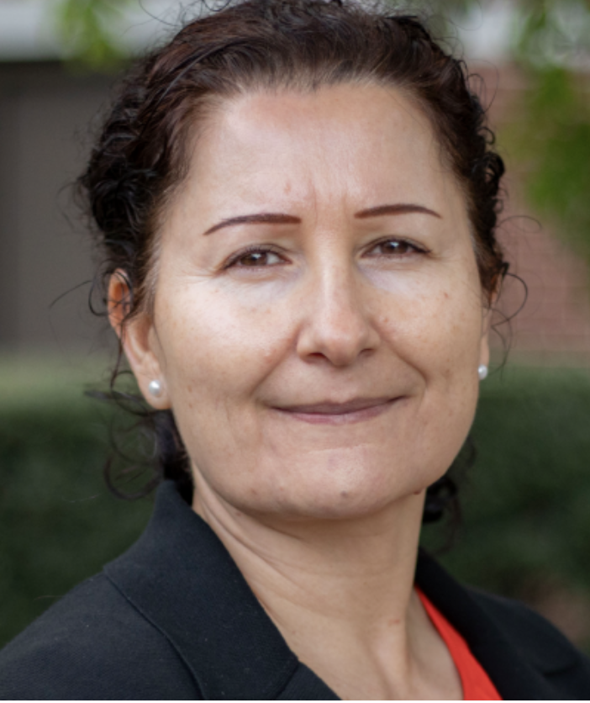
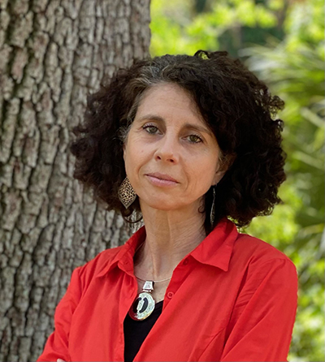

Who we are
Dr. Nargiza Ludgate
Local Capacity Development CCT Lead
Feed the Future Innovation Lab for Livestock Systems |University of Florida
rnargiza@ufl.edu
Dr. Renata Serra
Enabling Environment CCT Lead
Feed the Future Innovation Lab for Livestock Systems |University of Florida
rserra@ufl.edu
Taryn Devereux
Training Consultant
Feed the Future Innovation Lab for Livestock Systems | University of Florida
taryndev@gmail.com
Notes:
2 min

Slide 4
Introductions
Name, institution, project

Slide 5
Writeshop Objectives
Introduction to policy brief development process
Sharing of policy brief template(s)
Developing the Heading, Key Messages, Content Outline, and Key Recommendations
Sharing next steps and timeline commitment

Slide 6
What makes a good policy brief?
Key Qualities of Effective Policy Briefs
  Concise and easily understood
  Focused on a specific issue/problem
  Evidence based
  Accessible (language and mode) to target audiences
  Action/Policy oriented

Slide 7
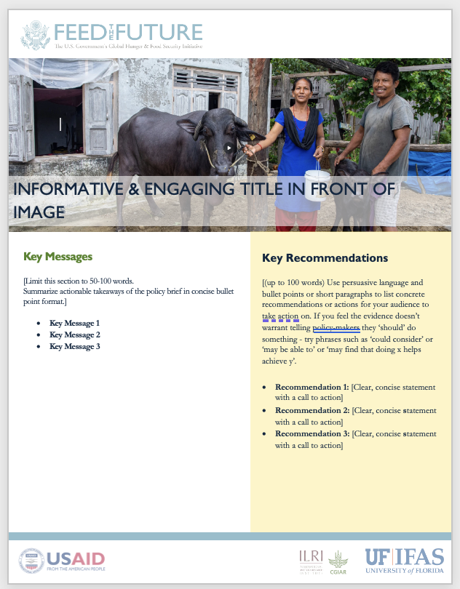
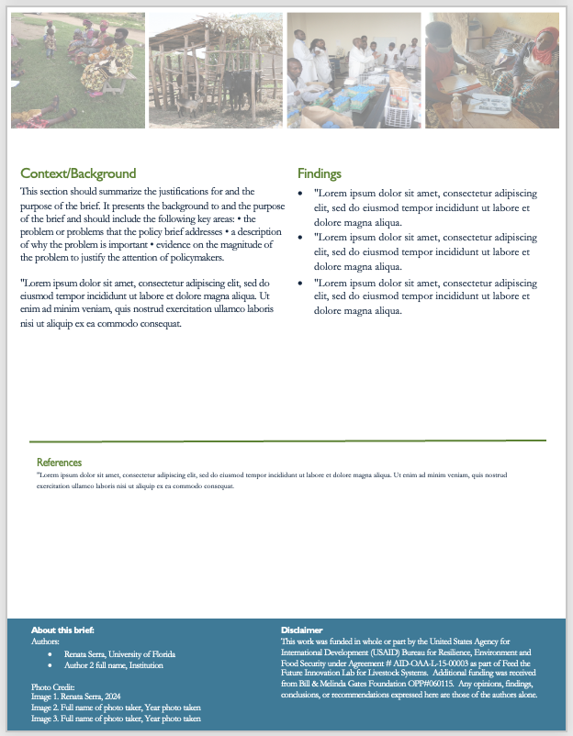
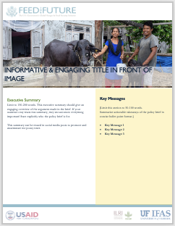
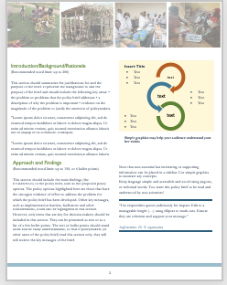
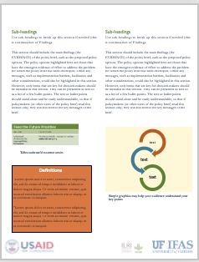
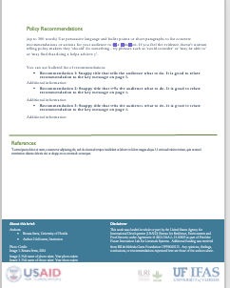
Policy Brief templates
2-page or 4-page templates
Choice between LSIL branded and non-LSIL branded templates
  However, you will have to include LSIL Acknowledgement for any LSIL funded project
Style of writing: Non-scientific, simple language that's accessible and easy to understand by anyone, especially the policy makers

Slide 8
Title
  Must be short, descriptive, and catchy
  It may indicate your policy recommendations
  You may have a title (for a general overview) and a subtitle for more specific explanations

Slide 9

Choosing your target audience
Stakeholder are people who have a stake in, may affect or be affected by the policy implications of your project.
Communities, industries, decision-makers, policy makers, state agencies etc.
You are to map and list who these actors are, as they will be the ultimate users/target of your policy brief.

Slide 10
Interactive Activity
Work in group: Write on stickies and paste on the flipchart
What is your PB Title?
Who is your primary audience for this Policy Brief?
Do you have any secondary audiences? Who is your secondary audience?

Slide 11
Break!
Notes:
~10:50 am

Slide 12
Key Messages

Slide 13

What is a Key Message?
A short bullet point summarizing the most important take-home message.
A key message is the main point of information you want your audience to hear, understand, and remember.

Slide 14
Crafting Key Messages
  Limit to 2 or 3 key messages and link them to the policy recommendations you will be making
  Keep messages simple and succinct
  Avoid jargon and make messages appealing and relatable to your audience

Slide 15
Writing time – 60 min
Now it is your time to write:
  Work on Key Messages
Share and listen

Slide 16
2. Content Outline/Development

Slide 17
Content outline / Development
Think through the structure of the brief:
  How are you to describe the problem to be addressed?
  What is needed in the introduction/background/context section for the audience to understand what your contribution is about?
  Be selective: you are to include only the research findings or activities that speak directly to your problem and will contribute to the policy recommendations
  How will you describe research or other activities in non-technical language?

Slide 18
Writing time – 60 min
Now it is your time to write
  Work on Outline of the Main Content
Share and listen

Slide 19
Lunch Break

Slide 20
3. Policy Recommendations
Notes:
~11am

Slide 21

What are policy recommendations?
Actions that you recommend decision-makers take, based on your research findings or other evidence that you have provided
We suggest that your policy recommendations link back to your key messages

Slide 22
Crafting Policy Recommendations
  Avoid long list of general recommendations
    Provide specific actions to be taken and by whom
  You may indicate alternative policy options
    These should be based on evidence you provided
    Realistic effects of each option need to be clear
    Underlying conditions/assumptions need to be spelled out

Slide 23
Writing time – 60 min
Now it is your time to write
  Work on Policy Recommendations
Share and listen

Slide 24
4. Validation and Dissemination Process

Slide 25
Validation
WHY
Ensure that the policy brief is not only read but acted upon
Necessary step to get feedback from key actors who will be instrumental to its diffusion and uptake
HOW
Event for soliciting feedback from your chosen group of stakeholders – best, collective feedback is more effective
Individual consultations to solicit individual feedback (in person or virtually)

Slide 26
Dissemination
Think of a high-level public event with large number of stakeholders and advertise the event (media, blogs, etc.)
Have your key stakeholders play a key role (opening and/or closing, leading sessions on select topics)
Ensure actionable next steps are agreed upon with a timeline
LSIL (through the EE CCT budget) is willing to support financially and/or logistically such an event. Talk to us!

Slide 27
Creating a plan for
Validation & Dissemination
Group exercise (if time allows it):
  Let’s brainstorm and then share ideas for validation and dissemination

Slide 28
Next steps

Slide 29
Policy brief development TIMELINE
TIMELINE | ACTION
4 October 2024 | Introduction and key elements: audience, content, template, timeline, lead writer
Two weeks before Check-in Session 1 | Submit 1st draft of policy brief using LSIL provided template
November/December | Virtual Check-In Session 1 (max 2 hours)
Two weeks before Check-in Session II | Submit 2nd draft of policy brief addressing LSIL feedback from session 1
January/February 2025 | Virtual Check-In Session 2 (max 2 hours)
Project based | Validation Workshop with key stakeholders
Two weeks before Check-in Session 3 (last) | Submit final draft of policy brief addressing feedback from validation workshop
March/April 2025 | Virtual Check-In Session 3 (max 2 hours)
End of April 2025 | Submit final policy brief to LSIL team Publishing and dissemination with a wider audience

Slide 30
Lead author
The Lead Author is the person responsible to lead the development of the policy brief (e.g., primary author) as well as the contact person between the project and LSIL Policy Brief team
Identify and introduce the lead author for policy brief from your project:
  Full name and Email address

Slide 31
Questions, concerns, suggestions
What questions, concerns and/ or suggestions do you have?
Utilize free version of Grammarly to help you with writing (checks grammar, spelling, punctuation, etc.)

Slide 32
Thank you!
PLEASE TAKE OUR 5-MINUTE SURVEY
Let us know how this Writeshop compares to similar others you may have taken.
Thank you!
insert survey link
insert survey QR code here

Slide 33


