Slide 1
Academic writeshop
WELCOME & INTRODUCTIONS
Day 1
Feed the Future Innovation Lab for Livestock Systems

Slide 2
Welcome to Academic Writeshop
ACADEMIC WRITING
A formal style of writing used in scholarly work, such as research paper, thesis/dissertation, research essay, or publication manuscript
WRITESHOP
A ‘learning and doing’ type workshop where participants learn, draft, present, review, & revise their writing in a set timeframe
ACADEMIC WRITESHOP
An intensive workshop where participants engage in learning and active writing, sharing, reviewing, and re-writing their scholarly work
Notes:
Formal style means writing in clear formal technical language (not slang or colloquial), referencing the work of other scholars to discuss a topic or make an argument, debate or answer a specific research question and presenting written piece in a logical layout and structure.

Slide 3
Academic Writing
“Scientific writing is a trade, not an art, and it must be and can be learned.”
Benno ter Kuile, 2024

Slide 4
Why this workshop
Examine the problem
Research
Plan
Write
Publish
Enhancing research and writing skills
Working and learning from peers
Learning publishing trends and best practices
Relevant to any discipline
Getting started with writing…
The writing process

Slide 5
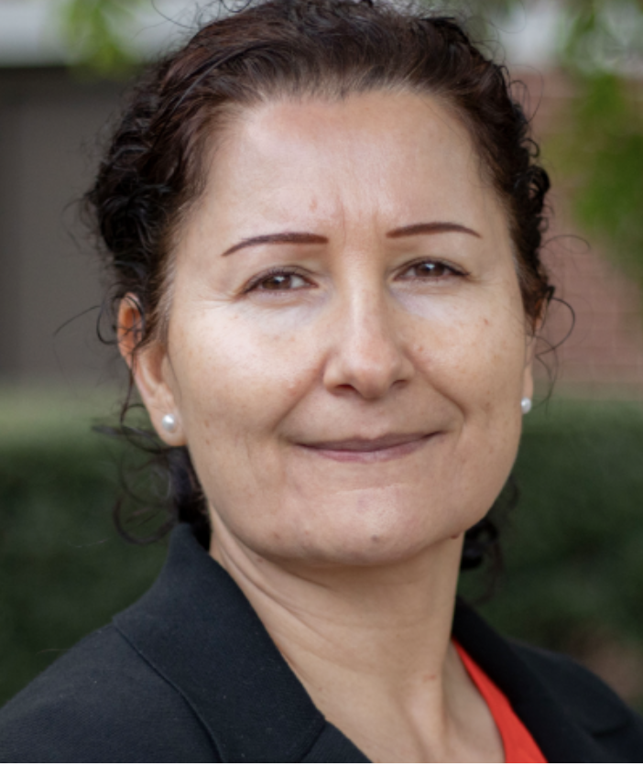
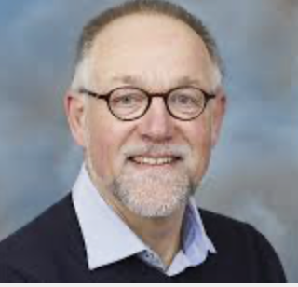
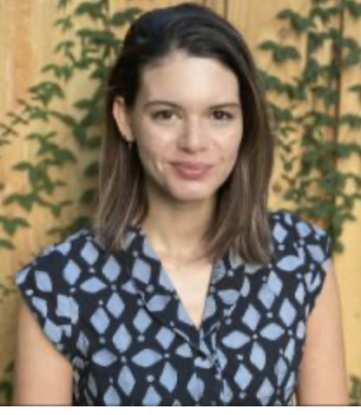
Our team
Dr. Nargiza Ludgate
Local Capacity Development CCT Lead
Feed the Future Innovation Lab for Livestock Systems |University of Florida
rnargiza@ufl.edu
Professor Arie Havelaar
Human Health, Food Safety, Diets & Nutrition AOI Lead
Feed the Future Innovation Lab for Livestock Systems |University of Florida
ariehavelaar@ufl.edu
Taryn Devereux
Training Consultant
Feed the Future Innovation Lab for Livestock Systems | University of Florida
taryndev@gmail.com

Slide 6
Writeshop objectives
1. Familiarize LSIL partners with the participatory academic writing process
2. Guide participants in navigating the world of journal article publishing
3. Get participants started on academic writing in a peer-reviewed journal
4. Guide participants in bringing their manuscript to journal quality

Slide 7
Structure of the writeshop
Day 1
Manuscript writing starts with a good study design
Articulating the research objectives and Methods section of the paper
Good writing practices discussion
Telling the story: Ways to present Results
Selecting the right journal for your manuscript
Writing block
Day 1
Placing results into broader context
Organizing the supplementary information
Utilizing online tools and resources to support publishing
Writing block
Getting research results out quickly amidst challenges
Peer review
Next steps and ORID

Slide 8
Now let’s learn who is in the room
Take post-note and write answer to the following question
Come Forward to the flipchart and introduce yourself
Your Name – Institution – What you do as a researcher
Stick your post-note on the flip-chart and share what you wrote
What helps and what hinders academic writing?

