Slide 1
Academic writeshop
SELECTING THE RIGHT JOURNAL FOR YOUR MANUSCRIPT
Day 1
Feed the Future Innovation Lab for Livestock Systems

Slide 2
Outline
Considering different factors in selecting the right journal to publish
Staying away from predatory journals
Other approaches to publishing
Activity: Crowdsourcing journals

Slide 3
Opening question
How do you identify a journal to publish your work?
Do you publish in the same journal?

Slide 4
Considering FACTORS IN SELECTING a JOURNAL
Talking to colleagues where they publish
Considering the journal impact factor
Who are the readers of the journal? Will the message reach the right audience?
Understanding the aims and scope of the journal
What type of publication (e.g., original research, review articles, short reports, case study, etc.)?
Publication mode and rights (the right of first publication, permission, open access, copyright)
Publisher type (traditional subscription-based journal, open access journal, hybrid journal)
What are the publication fees?
Publication frequency

Slide 5
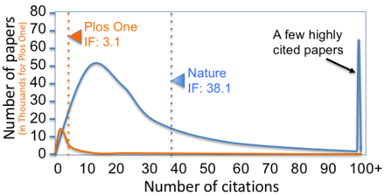
What is the Journal impact factor?
A statistical measurement to determine journal importance by calculating how often its articles are cited (i.e. yearly mean number of citations of articles published in last two years).
Notes:
Image from Wikipedia (https://en.wikipedia.org/wiki/Impact_factor)

Slide 6
Does Journal Impact factor matter?
PROS
Endorsement by the community that your research is worthy.
CONS
Aggregate does not equal individual!
Your research results are the same no matter which journal they’re published in.
Some fields just don’t have high impact factor journals.
Lower impact factor journal may get you published faster.
Translates into prestige valued by grant donors, job hiring committees, etc.
Publishing in high impact factor journal will give more credibility to your work.
High chances that your work will be read and cited.
High impact journals tend to be expensive.
High rejection rates; high-impact journals consider the novelty and appeal of the message.
Notes:
Source: Should you care about Journal Impact Factor? | Scientific Writing
Impact factor acts as a proxy to prestige and visibility
However, do you always need to consider the impact factor?
For cons
Aggregate does not equal individual!
JIF is an aggregate value calculated based on citations of the individual articles in a journal. But because citation counts are highly variable among articles, JIF cannot tell us anything about the quality of any given individual article.
Your research results are the same no matter which journal they’re published in.
If your research is strong, people are going to find it. If you put the right keywords in your article Google Scholar, Web of Science, and Scopus, will get your work to the right people. Lower Impact Factor journal may get you published faster

Slide 7
Other considerations
Reputation and peer-review process – Thorough and transparent peer-review process
www.Thinkchecksubmit.org
Author Support Services – Quality of communication during peer-review, editorial assistance, marketing and promotion of the published work, post-publication support.
Ethical Practices & Mission – Choosing publishers that prioritize science & public knowledge over financial gain.
Commitment to Diversity, Equity, and Inclusion (DEI) – Checking DEI policies, diversity of published authors, and peer review processes.
Open access and affordability – Looking for publishers that offer discount and waiver policies for the article processing charge.
Predatory publishers…let’s go to next slide!
Notes:
Source: "Choosing a Publisher? It's not all about the impact factor" (Messaritaki, 2024)

Slide 8
Staying away from predatory journals
Present themselves as legitimate publications, but use the OA publishing model to dupe authors into paying them fees.
Sow confusion, promote shoddy scholarship and waste resources.
Can be difficult to define or identify.
Options:
Notice if multiple and/or aggressive demands to pay APC; inconsistent messages or emails;
Use resources like www.Thinkchecksubmit.org
Other tips?
"Predatory journals and publishers are entities that prioritize self-interest at the expense of scholarship and are characterized by false or misleading information, deviation from best editorial and publication practices, a lack of transparency, and/or the use of aggressive and indiscriminate solicitation practices."
Notes:
Source:
"Predatory journals: no definition, no defence" (Grudniewicz, et al 2019)
"How universities can assist in foiling predatory journals" (Boukacem-Zeghmouri, 2023)

Slide 9
What to prepare / consider
Decide the format of your paper – full-length original research, or brief technical report?
Identify at least 5 journals to submit your manuscript, of different impact levels.
Check their schedules for open submissions. Is it quarterly/annually? Look for Special Issue options.
If special issue, tailor your manuscript to place it within special issue scope and topics
Ensure that you meet all submission requirements of target journal. Consider forms, cover letters, formats, etc.
Take advantage of pre-submission inquiries. Some allow you submit an abstract or summary for feedback.
Notes:
Content in part sourced from: "A step-by-step guide to creating a journal publication schedule" (Editage Insights, 2018)
This source includes a downloadable template for a publication schedule.

Slide 10
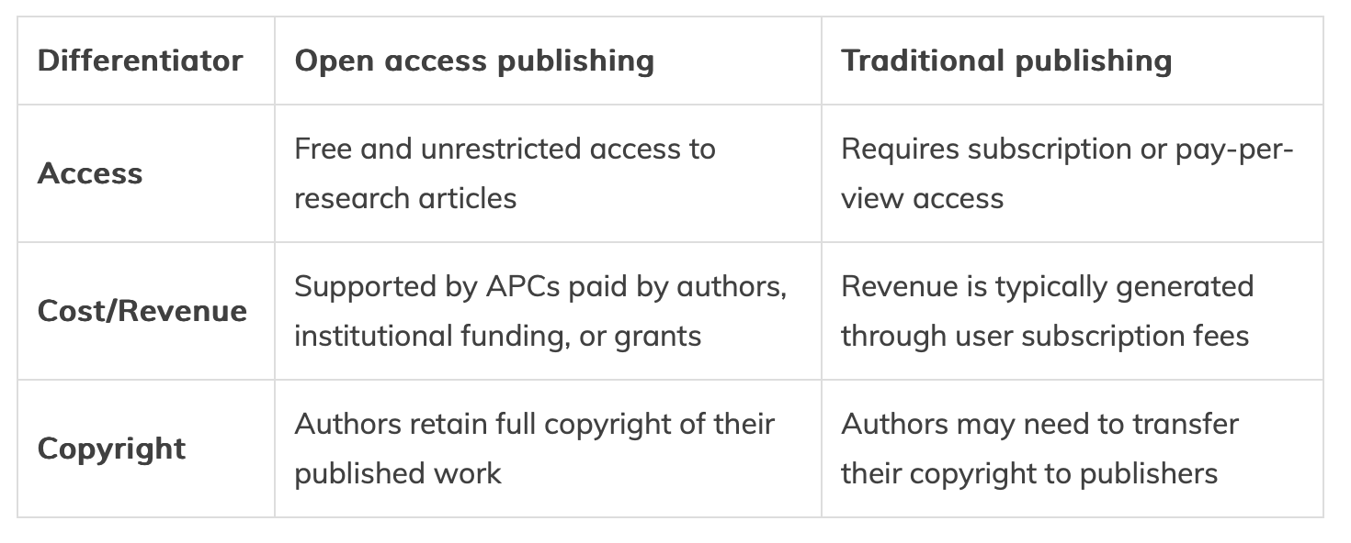
open access vs traditional publishing
Notes:
Source for table: https://researcher.life/blog/article/open-access-vs-traditional-publishing/

Slide 11
A few more words about Open-access
Article processing charges (APCs) are in the range of several thousands to over ten thousand US$ for making their articles Open Access.
Creates significant barriers to publishing, especially for researchers in Global South.
Waiver policies are usually on the journal websites; research funders may pay for APC but their policies are volatile; institutions may have contract with journals for reduced or even fully paid APCs, usually if the corresponding author is from that institution.
Options (if it's a legitimate journal)
Check with co-authors and/or your institution for financial support.
Contact the journal directly to inquire about assistance options or flexibility with APCs (e.g., discounts, vouchers or fee waivers).
Notes:
Content based on: "How can I publish open access when I can't afford the fees?" (Forrester 2024)

Slide 12
Targeting journals in non-traditional to you research disciplines
Reaches broader audience or different readers you traditionally target!
Example: Manuscript focused on Child Nutrition and Animal Sourced Food (ASF) is published in a journal to target Animal Production experts and not necessarily the Public Health experts.

Slide 13
Pre-print servers
Preprint Repositories
arXiv. arXiv is a preprint server for physics, math, computer sciences, quantitative biology and statistics
Authorea. Authorea is a platform for publishing articles, data, figures and preprints
VeriXiv.
bioRxiv.
ChemRxiv.
Figshare.
medRxiv.
Open Science Framework (OSF)
Preprints.org
A preprint, also known as the Author's Original Manuscript (AOM), is the version of your article before you have submitted it to a journal for peer review.
It is a public online repository enabling you to get your work out early!
Notes:
https://gatesopenresearch.org/for-authors/publish-your-research

Slide 14
Research Notes & Technical reports
Targeting non-scholarly audience through non-scholarly channels
Research Notes
Technical Notes
Policy Briefs
Blogs
Other non-scholarly knowledge products
Broader audience, especially reaching the policy/decision makers!
Increases visibility of your research among the general public!

Slide 15
Activity: Crowdsourcing journals
Journals you shared in the survey
Advances in Agriculture
Cogent Food & Agriculture
Journal of Bee Science
Transboundary and Emerging Diseases
Veterinary Research
Livestock Science
Genetic Resources
PLOS One
Journal of Sustainable Tourism
International Review of Financial Analysis
Journal of Accounting and Economics
Journal of Financial Stability
NARC journal
SAS journal
Field Crop Research Journal
Grass and Forage Science Journal
Let's create a collective list of relevant journals, special issues, and other opportunities for academic publishing
Working in groups created by discipline (optional)
Consider publication timeline, APCs, JIF, etc.
Use Post-it notes to write your suggestions. At the end place them on the flipchart.
This will be shared with the group following this writeshop.

Slide 16
Questions

