Slide 1
Academic writeshop
MANUSCRIPT WRITING STARTS WITH A GOOD STUDY DESIGN
Day 1
Feed the Future Innovation Lab for Livestock Systems

Slide 2
“To write a good research article, you first of all do good research and for that you must have in the back of your mind what science is, and how it is best carried out. The writing itself should be the final step in a long process that starts with formulating a research question, followed by performing the right experiments to collect a coherent dataset that answer this question. Proper interpretation and designing graphs and tables to best present the data are not trivial either. Only when you have an outline consisting of the graphs and tables in the correct order and a few points you want to mention about each of these, does it make sense to start writing…”
Benno ter Kuile, 2024
Notes:
"Life Sciences Research and Scientific Writing" (ter Kuile, 2024)

Slide 3
What makes a good study design
Discussion:
List characteristics of a good study/research design
Capturing ideas on the flipchart

Slide 4
What makes a good study design (2)
UNBIASED
RIGOROUS
POWERED
CITED
REPRODUCIBLE
APPLICABLE
Well formulated research problem and question(s)
Well-defined theory or conceptual framework
Embedded in scientific integrity and ethics
Applied best practices for collecting, analyzing, and presenting data
Considered and tailored to readership / audience
Key characteristics of a study design
Notes:
Key elements of a well-designed study
Make sure your study is adequately powered.
Ensure your study is unbiased.
Consider the range of applicability of your study.
Ensure the study is replicable or reproducible.
Indicate the uncertainty in your results.
Cite references and further reading.

Slide 5
A Well-Formulated research question or problem
Clearly states the problem
Not too broad and not too narrow
Researchable
Supported with rigorous analytics
Every research project has a main question it attempts to address:
What is unknown about your subject but worth knowing?
All methods applied is designed to answer that question.
A well formulated research question is the foundation stone of any research.
Source: ter Kuile, 2024
Notes:
"Life Sciences Research and Scientific Writing" (ter Kuile, 2024)
A well-formulated research question is the foundation stone of any research. It guides the researcher in determining the study’s objectives, planning the right methodology, collecting and analyzing data, and drawing inferences. A research question determines the scope and direction of the study, ensuring that the study stays focused and avoiding needless diversions. Secondly, a research question plays a pivotal role in defining the study’s methods. It directs the choice of methods for gathering and analyzing data, ensuring that the study is designed to produce reliable and robust results.

Slide 6
What defines a good theory?
A theory must explain the observations by putting them into a framework in a way that also has predictive value.
A good theory remains as simple as possible while still accommodating all experimental observations.
Occam's Razor: The principle that the simplest explanation, with the least elements and fewest assumptions, is preferable over more complex alternatives.
Source: ter Kuile, 2024
Notes:
"Life Sciences Research and Scientific Writing" (ter Kuile, 2024)

Slide 7
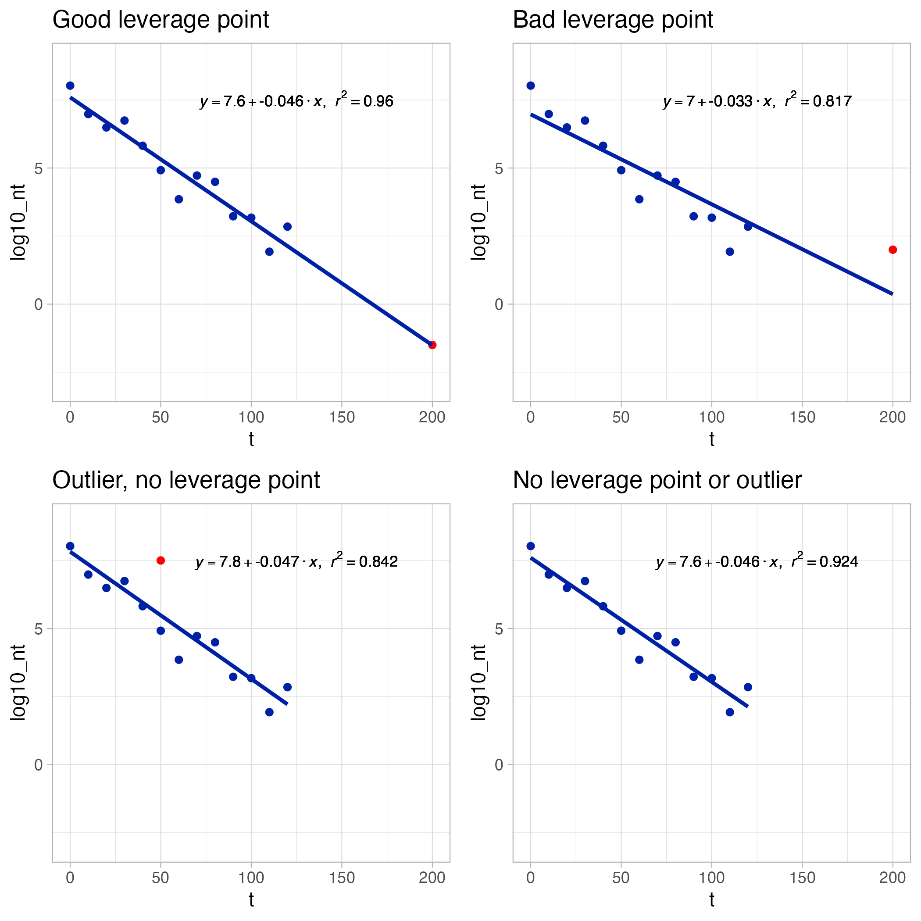
Outliers vs. Leverage points
Notes:
In this section, we learn the distinction between outliers and high-leverage observations. In short: An outlier is a data point whose response y does not follow the general trend of the rest of the data. A data point has high leverage if it has "extreme" predictor x values.
Good leverage points , are observations that are outlying in the space of explanatory variables (i.e., have characteristics that are different from the bulk of data) but that are located close to the regression line.
Bad leverage points , are observations that are outlying in the space of explanatory variables and that are located far from the regression line.

Slide 8
Interpretation
(Ideally) scientific arguments are about interpretation of data and measurements. Both sides agree on what is known and not known but argue about how to interpret and understand the outcome of the research.
In science valuable insights are sometimes obtained by combining two mutually exclusive concepts.
“A scientific hypothesis cannot be proven but can be rejected if not confirmed by the data. A hypothesis is accepted until rejected.”
A good dispute is healthy for science!
Source: ter Kuile, 2024
Notes:
"Life Sciences Research and Scientific Writing" (ter Kuile, 2024)
Source: Arie Havelaar

Slide 9
Scientific integrity
SCIENCE IS BUILT ON HONESTY AND RELIABILITY
Code of Conduct
Do not fabricate
Do not falsify
Do not plagiarize
Source: ter Kuile, 2024
Notes:
"Life Sciences Research and Scientific Writing" (ter Kuile, 2024)

Slide 10
Let’s stop on “Do not falsify”
There are many variants from the intentional to the innocent.
Not a single data point or set of observations can be removed without being reported because they don’t fit in the theory or even in the pattern of other data unless an experimental error has been identified.
Notes:
Source: Arie Havelaar

Slide 11
Truth and truthful
Faking data is not only unethical – it also deprives you of the most interesting findings.
The processing and reporting of data must be done with utmost care.
A report is true if real measured data and actual observations are reported, and truthful if they are reported in such a manner that the reader gets the right notion and is guided to draw the correct conclusions.
In science, the separation between facts and interpretation matters even more.
Source: ter Kuile, 2024
Notes:
"Life Sciences Research and Scientific Writing" (ter Kuile, 2024)

Slide 12
Ethical considerations
Authors’ responsibilities
Adhere to reporting standards Ensure data access and retention Ensure originality and acknowledgement of sources No multiple, redundant or concurrent publications Ensure confidentiality Authorship of the paper Acknowledge the use of generative AI and AI-assisted technologies in scientific writing and in figures, images and artwork
Informed consent, confidentiality/anonymity, voluntary participation, deception, risk of harm, accuracy in analysis and reporting are some of the core ethical principles that must be considered and planned for designing and carrying out research.
Ethical Review Committees are research bodies within research/academic institutions that review all research proposals to ensure adherence to ethics, and, above all, protection of human subjects or animals.
Check publisher’s Guide for Authors and or the International Council of Medical Journal Editors (ICMJE) and Consolidated Standards of Reporting Trials (CONSORT) which are gold standards for publishing scientific work.
Notes:
For human subjects, the author should ensure that the work described has been carried out in accordance with The Code of Ethics of the World Medical Association (Declaration of Helsinki) for experiments involving humans.
All animal experiments should comply with the ARRIVE guidelines and should be carried out in accordance with the U.K. Animals (Scientific Procedures) Act 1986 and associated guidelines, or EU Directive 2010/63/EU on the protection of animals used for scientific purposes, or the U.S. Public Health Service Policy on Humane Care and Use of Laboratory Animals and, as applicable, the Animal Welfare Act.

Slide 13
Collecting, analyzing & presenting data
Collecting
A process of gathering and measuring information on variables of interest, in a systematic way to answer a stated research question, test hypotheses, and evaluate outcomes.
Analyzing
A process of systematically applying statistical and/or logical techniques to describe and illustrate, condense and recap, and evaluate data.
Presenting
Stand-alone
Professional
Strong captions
A process of comparing two or more data sets with visual aids, e.g., graphs, tables, figures
Notes:
The data is often collected and presented in narrative form, with the use of visualization in the form of textual tables, diagrams and other images. Qualitative data is typically collected through interviews and/or focus groups, observation and document review, using semi-structured techniques and open-ended questions
Formulate in your mind the main storyline that the paper will tell. Then select the data that most clearly support it and decide how to present those - "Life Sciences Research and Scientific Writing" (ter Kuile, 2024)

Slide 14
Who are The readers?
No two specialists know the exact same things.
Try to imagine which information must be considered generally known and what needs to be mentioned even to experts in the field.
Broader readership often requires different writing style and type, e.g., Review Article.
Notes:
"Life Sciences Research and Scientific Writing" (ter Kuile, 2024)

Slide 15
Discussion (15 min)
Working in pairs: Find your pair and discuss
“Good study design facilitates publication”
Which characteristics of a good study design make publication easier?
Develop a list and be ready to share
Regroup: Pairs share their list and key points are captured on the flipchart

Slide 16
Discussion (15 min)
Work in groups: Form groups and discuss the meaning of the above statement in each group
"Authorship starts with data collection"
Do you agree or disagree, and why?
Regroup: Groups present their discussion and whether they reached a consensus Key points captured on the flipchart

Slide 17
Additional resources
Helicopter science series at the University of Florida
https://internationalcenter.ufl.edu/research/challenging-helicopter-science
Scroll down to find Helicopter Science Workshop Series (Spring 2023 Semester). You can view recording and PowerPoint presentations.
Guidelines for assigning authorship (a Livestock Systems Innovation Lab blog)
s.ifas.ufl.edu/lsil/2024/07/11/guidelines-for-assigning-authorship/

Slide 18
Questions

