Slide 1
Academic writeshop
INTERACTIVE PANEL & DISCUSSION
“GOOD WRITING PRACTICES”
Day 1
Feed the Future Innovation Lab for Livestock Systems

Slide 2
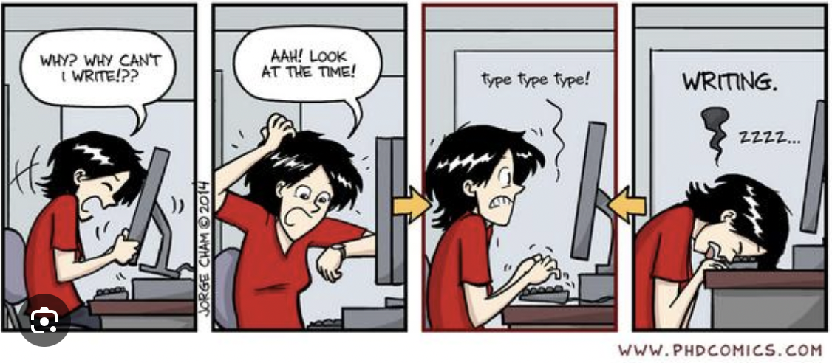

Slide 3
Good writing practices
Block writing time
Pair/form a writing group
Make a plan to write
Create a conducive space
“Pomodoro” method
Read widely & diversely
Notes:
The Pomodoro Technique (Set your timer and work hard for 25 minutes, then take a five-minute break. Repeat the process for as long as needed or as long as you can and every fourth round, be sure to take a longer break – half an hour is ideal.)

Slide 4
Interactive discussion
Discuss in pairs (5 min)
What are good habits or practices for writing?
What works best for you?
Plenary discussion

Slide 5
Best practices you shared in the survey
Working with a major advisor, and a colleague to handle the publication steps
Follow the journal's guidelines, use Mendeley for referencing
Consult journal guidelines
Not such an idea of successful practices, but generally in-depth literature review and well explanation of methodology might have helped
Choosing the best topics
Following the writing format of the journal
Review of relevant papers, follow the guidelines
The idea about the best journal, the idea of critical writing, the idea of expressing words in a better way
More concern should be given to journal selection and there is a need of patience
The team discussed clearly and assigned the part of the article to each of the authors. Prepared a list of the previously published similar articles with a summary of the major findings
Systematic literature review and meta-analysis
Authentic research work, relevant work, readable and simple language use, no plagiarism

Slide 6
Best practices you shared in the survey (2)
Although I haven't published my paper yet, one is currently in process, and I would like to share my experience on it. I referred to 2-3 recently published articles from the journal and formatted my paper to align with their style. Additionally, I cited some papers from the journal to strengthen the relevance of my submission
Reworking the manuscript as advised by the reviewers
Excellent paper published due to more review by the reviewers
My topic was somewhat new and relevant. I used referencing software for referencing and citation. I worked hard on my writing skills to make my writing standard and clear.
Regular writing practice

Slide 7
Questions

