Slide 1
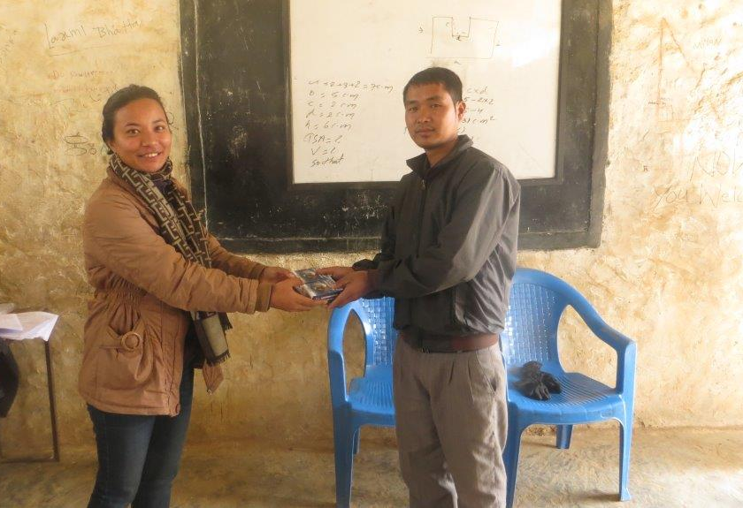
https://livestocklab.ifas.ufl.edu/projects/dr-richard-a-bowen/
Empowerment of village women for detection and control of livestock diseases in Nepal
October 2016 − March 2018
Principal Investigator
Dr. Richard A. Bowen, Colorado State University
Co-PI and Collaborators
Dr. Doj Raj Khanal, Private Consultant, Kathmandu
Nepal Agricultural Research Council
Ministry of Livestock Development
Himalayan College of Agricultural Sciences and Technology
Objectives
Establish a rapid reporting and response network for livestock disease based on women from the communities.
Develop or enhance the support structures necessary for success of the rapid reporting and response networks and preparation of the next generation of producers.
NEP_Bowen_CSU (Focus)
Notes:
Handing over of microscope to school teacher at Tindhare Pipal Dada School, Chargare, Nuwakot. Taken by Sidhi Bahadur Bajracharya in January 2018

