Slide 1
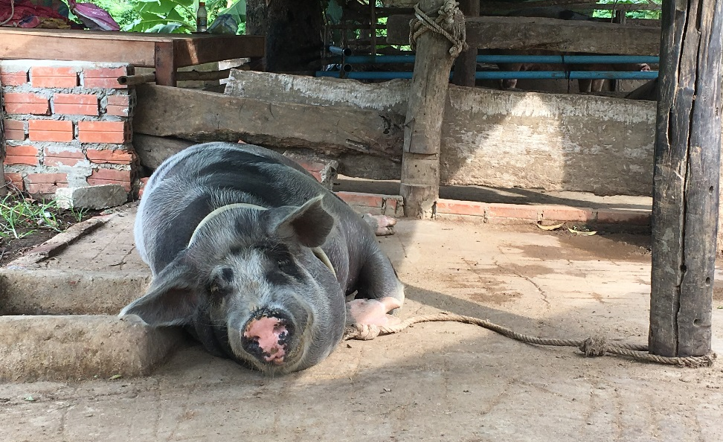
https://livestocklab.ifas.ufl.edu/projects/dr-michael-tokach/
Improved pig health and nutrition:
The major drivers of profitability and sustainability for smallholder farmers in Cambodia
July 2017 − May 2019
Principal Investigator
Dr. Michael Tokach, Kansas State University
Co-PI and Collaborators
Kansas State University: Dr. Lisa Tokach, Dr. Jessie L. Vipham
Royal University of Agriculture, Cambodia: Dr. Kang Kroesna, Chea Bunna
Objectives
Assess the nutrition composition of locally available feed resources in rural and peri-urban Cambodia and provide economical diet options and recommendations to smallholder farmers.
Assess the current disease management strategies on smallholder farms and in rural and peri-urban communities and provide practical recommendations for improved pig health outcomes.
CAM_Tokach_KSU (Focus)
Notes:
Photo copied from the presentation on “Introducing the Improved pig health and nutrition project” that Dr. Tokash gave during the IP Mtg 2017_08_31

