Slide 1
Introduction to
Good Lab Practices
Supplemental materials for Good Laboratory Management Training Manual for Trainers
Prepared by Richard Fethiere, University of Florida
FEED THE FUTURE INNOVATION LAB FOR LIVESTOCK SYSTEMS

Slide 2
Background
Importance of Good Laboratory Practice (GLP)
History of GLP regulations
Five fundamental points of GLP
Connection of the GLP materials to OECD Principles of GLP

Slide 3
Introducing the GLP manual
This training manual will serve as a tool for training and promoting GLP concepts in the laboratories that support livestock-related research
Materials related to GLP are located online at https://livestocklab.ifas.ufl.edu/resources/glp/

Slide 4
History of GLP regulations
In the 1970s, the U.S. Food and Drug Administrator (FDA) investigated several cases of poor practice in certain laboratories in the USA.
Investigation in 40 toxicology laboratories revealed many cases of poorly managed studies, poor personnel training, and some cases of deliberate fraud.

Slide 5
Outcomes of FDA investigation
FDA findings
Poorly-trained study directors and study personnel
Poorly-designed protocols
Protocols not followed and not conducted as prescribed
Raw data badly collected – not correctly identified – without traceability – not verified or approved by responsible persons
Lack of standardized procedures
Poor animal husbandry practices
Industrial BioTest laboratory was closed. Its directors received long prison sentences.
Cases of fraud were detected. However, most of the poor practices in laboratories were not fraud and could be dealt with by implementing a system of quality management in the labs.

Slide 6
Outcomes of the FDA investigation (Continued)
A new regulation to cover non-clinical safety studies related to health and the environment
Good Laboratory Practice (GLP) regulations drafted in 1976
Final regulation published in 1978
An enforceable US regulation in 1979
It is an American regulation, but it had a wide impact worldwide

Slide 7




PURPOSE OF GLP
Covers the quality management of non-clinical safety studies
The aim is to promote quality and validity of test data

Slide 8




Studies under GLP are:
  Reliable
  Repeatable
  Auditable
  Recognized by scientists worldwide

Slide 9
Why to follow GLP
THE PURPOSE IS NOT TO ASSESS THE INTRINSIC SCIENTIFIC VALUE OF A STUDY
GLP requires that scientists responsible for the organization of studies implement a clear organizational structure in compliance with GLP principles.

Slide 10
Why to follow GLP (cont.)
Scientists avoid getting false negatives from their studies
For instance, results could indicate the non-toxicity of a toxic substance.
Scientists avoid false positives
For instance, results could lead scientists to deduct that the test item is toxic when it is not.

Slide 11
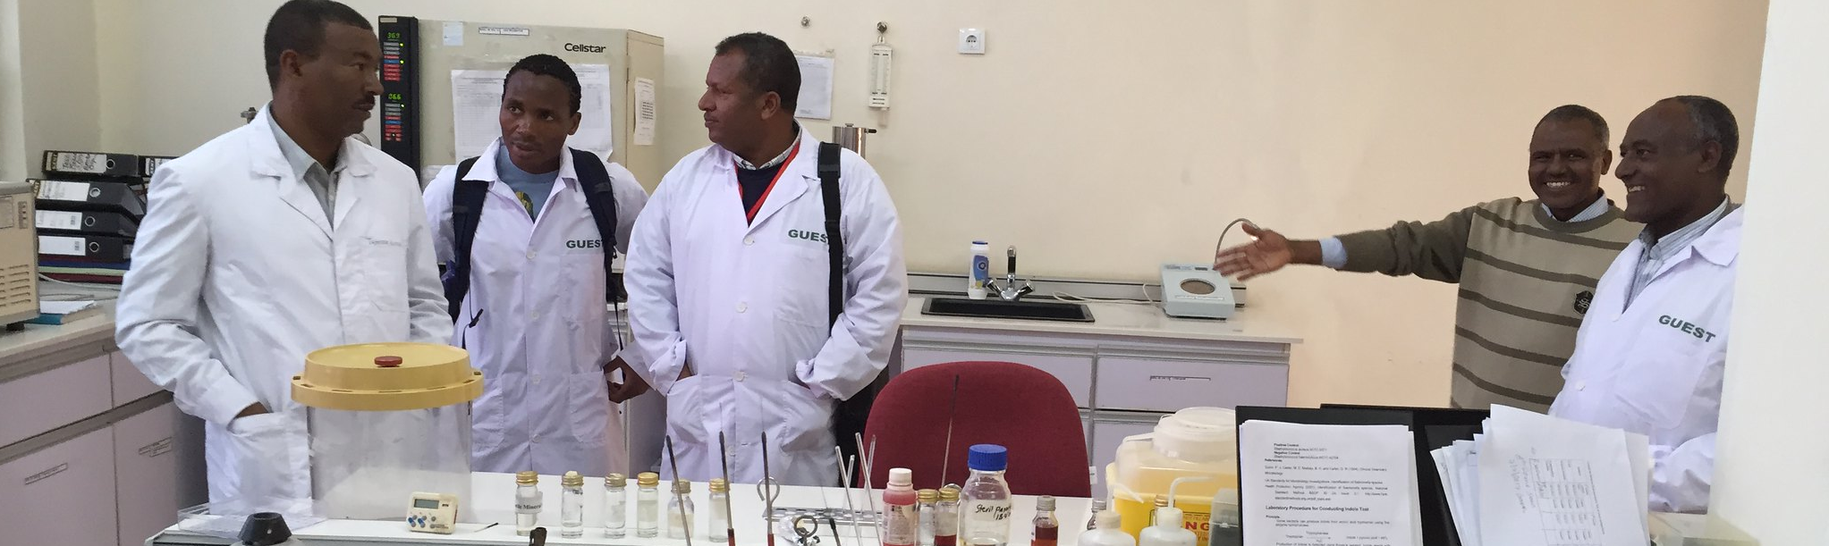
Key message:
Adherence to Good Laboratory Practice promotes mutual recognition of study data across international frontiers

Slide 12
Reasons for requiring GLP
Ensure high quality of results
2
Ensure comparability of results
3
Promote mutual recognition of results
4
Limit waste resources
1

Slide 13
GLP defines the working environment
  To ensure studies are:
Planned
Performed
Recorded
Reported
Archived
Monitored

Slide 14
Five fundamental aspects of Good laboratory practice
Resources: Organization, personnel, facilities, and equipment
Rules: Protocols, and procedures/study plans
Characterization: Test article, identification, and quality test system
Documentation: Raw data, final report, and archives
Quality assurance: Audit/inspection – training - advice

Slide 15
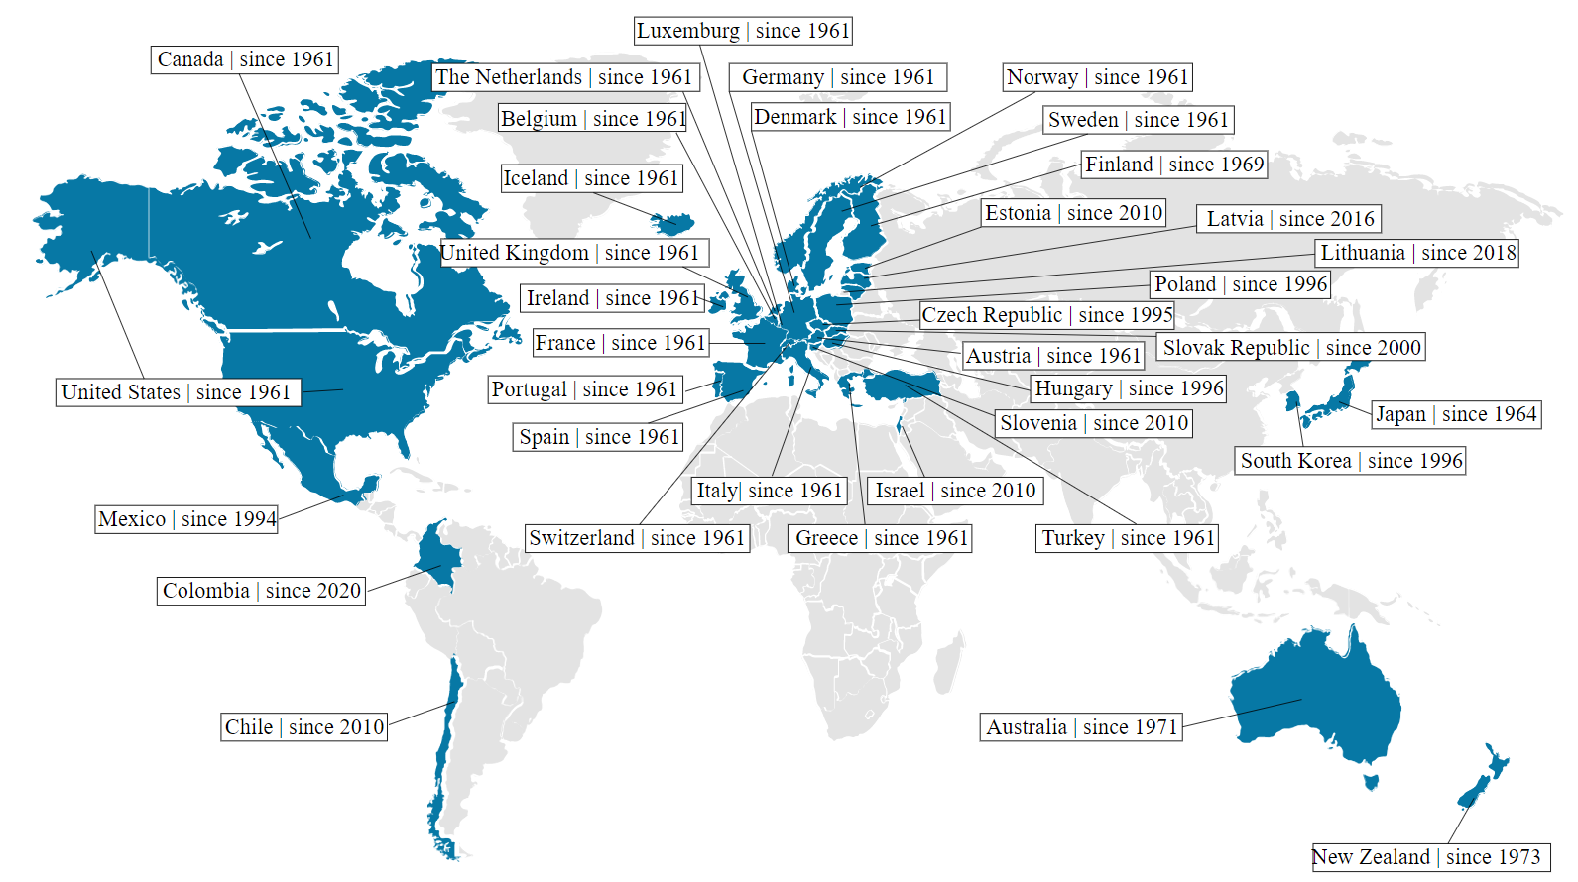
OECD Principles of GLP
Organization for Economic Cooperation and Development (OECD)
GLP Principles are recognized as an international standard
OECD Members | Year of Accession © DLR

Slide 16
The GLP materials are based on OECD Principles of GLP
1978
USA-FDA publishes its first regulatory document
1980
USA-EPA regulations relate to pesticides used in the field
1981
OECD GLP principles concern pharmaceuticals for human and veterinary use, cosmetics, etc.
1986
European Union develops GLP Directives

Slide 17
the OECD Principles of GLP
37 members as of 2019 including all European countries, the USA, Japan, and Colombia
Experts from all member states represent the views of each state
Functions as an international agency, state representatives have ambassador status

Slide 18
the OECD Principles of GLP (CONT.)
Agreed by all 37 member states
All states accept the validity of studies performed in compliance with OECD GLP
Known as the “MAD” agreement

Slide 19
GLP Group
Composed of heads of each national monitoring authority (at least 30)
The group meets regularly and plans how to promote GLP compliance among all OECD members
Plans OECD GLP activities, including special training sessions for inspectors
Verifies harmonization of approach between states

Slide 20
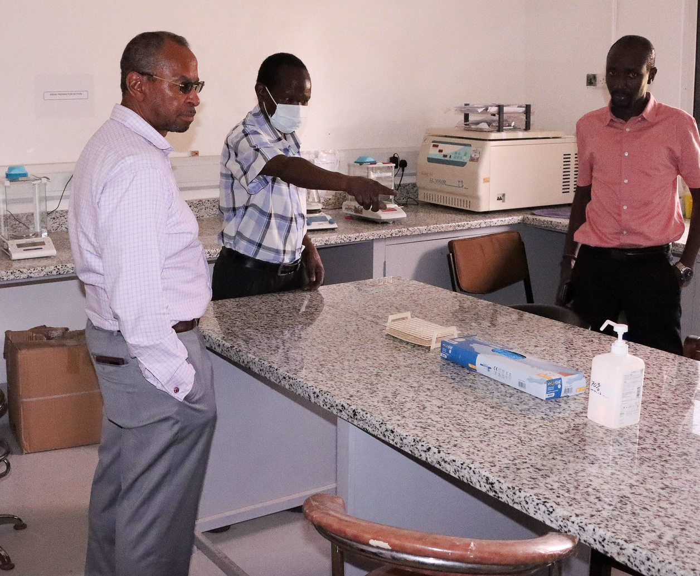
GLP principles have been revised
Latest version revised in 1997, published in 1998
The first part are the GLP principles, and the second part are the acts relating to GLP and compliance monitoring

Slide 21
OECD consensus documents
Quality assurance
Laboratory suppliers
Study director responsibilities
Field studies
Computerized systems
Responsibilities of the sponsor
Short-term studies

Slide 22
OECD - GLP
GLP regulations state that management must provide proper resources:
  Personal resources
  Physical resources
GLP requires that all resources are adequate for the task in hand
Management has responsibility for the scientific and organizational aspects of the study

Slide 23
OECD – GLP (Cont.)
Personnel
Study director
Quality assurance
Archivist
Physical facilities/ equipment
Administration
Individuals with administrative responsibilities
Good administrators commit to good sciences and apply good GLP principles
GLP requires a document where these administrators are identified
Management responsibility
Insure that GLP principles are respected
Insure adequate qualified personnel, physical facilities, equipment, and supplies
Keep records with qualifications, training, experience, and a description of jobs

Slide 24
Activity: brainstorm good science and good organization
Good Science
Good Organization

Slide 25
Activity: Brainstorm good science and good organization (Cont.)
Good science
Experimental design
Based on known scientific procedures
Control of variables
Interpretation of results
Results become part of an accepted body of knowledge
Good organization
Good facilities and qualified personnel
Study plan and resource allocation
Definition of personnel responsibility and training
Good record keeping and organized archives
Compliance with GLP
Adequate physical facilities and qualified staff
Planning of studies and resource allocation
Definition of staff responsibilities and training of staff
Good record keeping and organized archives
Implementation of verification processes
Compliance with GLP

Slide 26
Consult the Good Laboratory Management Training Manual for Trainers before using the Introduction to GLP Lecture https://livestocklab.ifas.ufl.edu/resources/glp/
Direct link to manual in PDF: https://livestocklab.ifas.ufl.edu/media/livestocklabifasufledu/pdf-/MANUAL-Fethiere_UF_Good-lab-management-practices_2022.pdf

